Slide 1
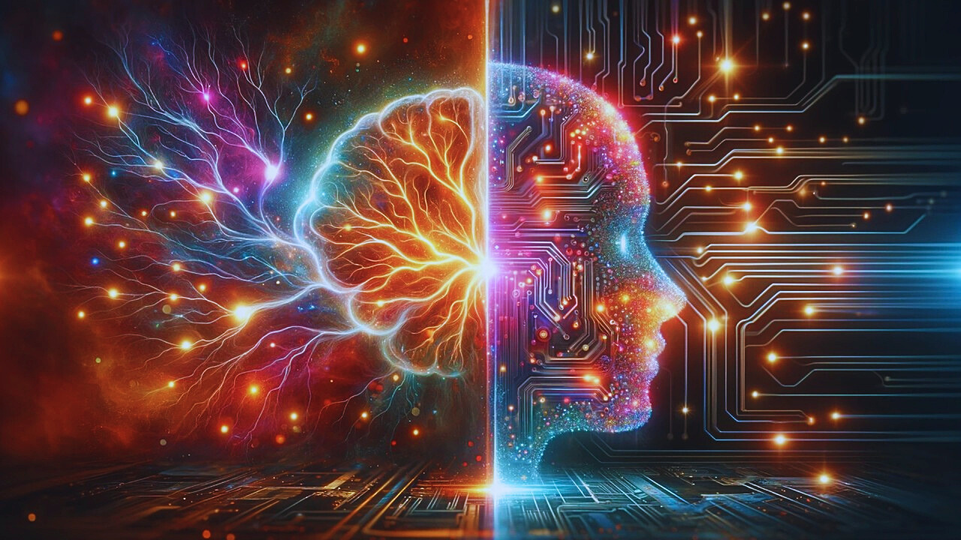


EMO-NET
EMOTION + NETWORK
Presented by
ARITRA DUTTA
SOHINI GHOSH
ARITRICK BHOWMICK

Slide 2

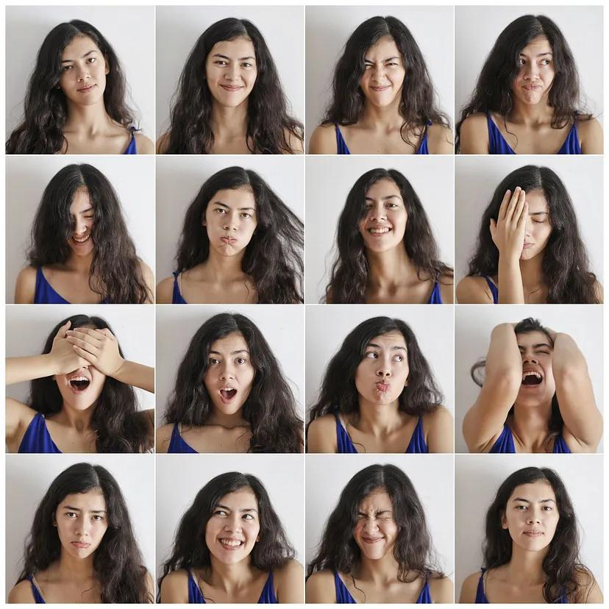
FACE EMOTION DETECTION
FACIAL EXPRESSIONS ARE A WAY OF COMMUNICATION WITHOUT USING ANY WORDS OR SYMBOLS. THESE EXPRESSIONS ARE A RESULT OF CHANGE IN THE POSITION OF EYEBROWS, NOSE, EYES, MOUTH AND CHEEKS.

Slide 3

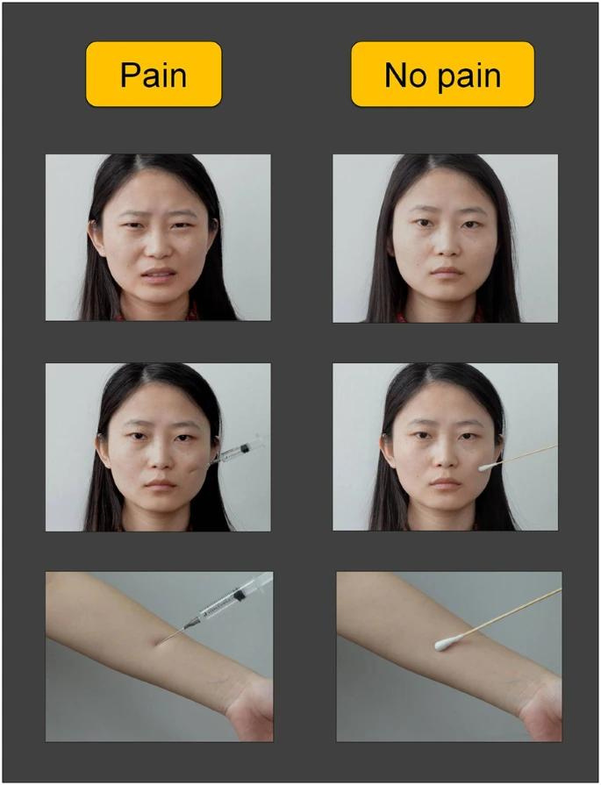
Application Areas
HealthCare
Pain Detection
Mental Health Monitoring
Medication effects

Slide 4

Application Areas
Online Meeting Platforms
Student/Participants Engagement
Participants Satisfaction

Slide 5
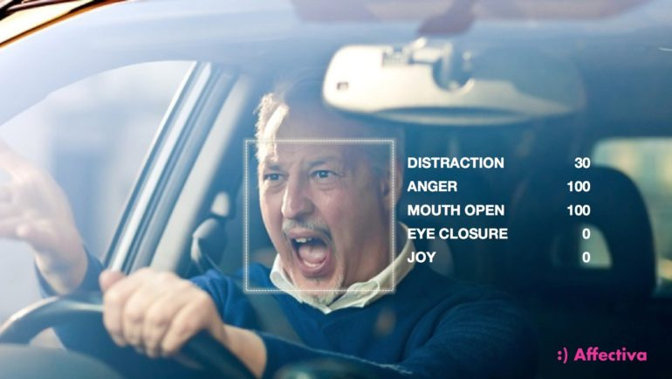
Application Areas
Automotive
Drivers’ Drowsiness Detection
Personalized in-car experience

Slide 6
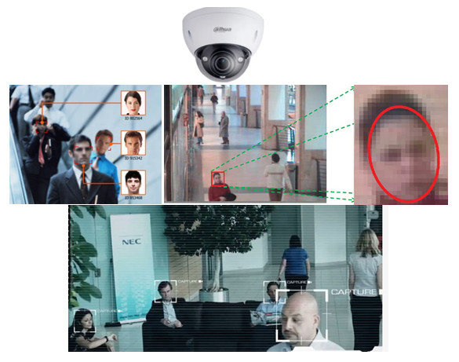
Application Areas
Security and Surveillance
Surveillance capabilities will be enhanced
Identifying individuals exhibiting suspicious or threatening behavior based on their facial expressions.

Slide 7



OUR APPLICATION AREA
Online Meeting Platform
Collection of images from multiple users from the meeting.
That is it will capture the emotions of all the individuals present in the meet and at the end will showcase the average percentage of all the emotions of each individual to the host.

Slide 8
WORK FLOW
1
2
3
4
PREPROCESSING OF DATA
TRAINING of pretrained model on the dataset
Comparative analysis on the dataset
Building our own 3 different models
5
6
7
8
Individually analysing accuracy of each model
Using the combination of 3 models to make predictions
Analysing the accuracy of the combination of the model
Finally deploying the model on our application

Slide 9
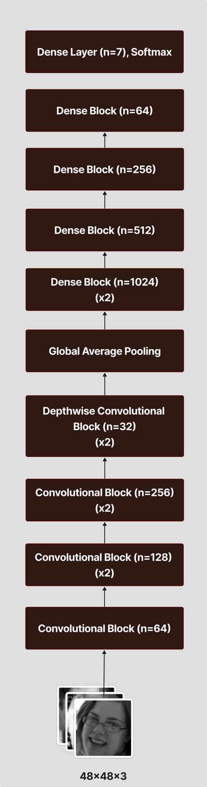
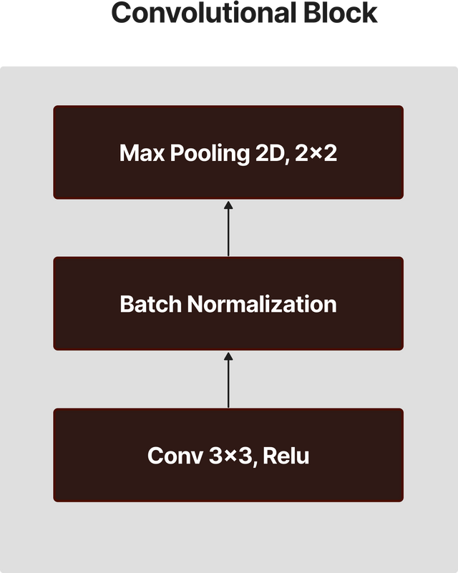
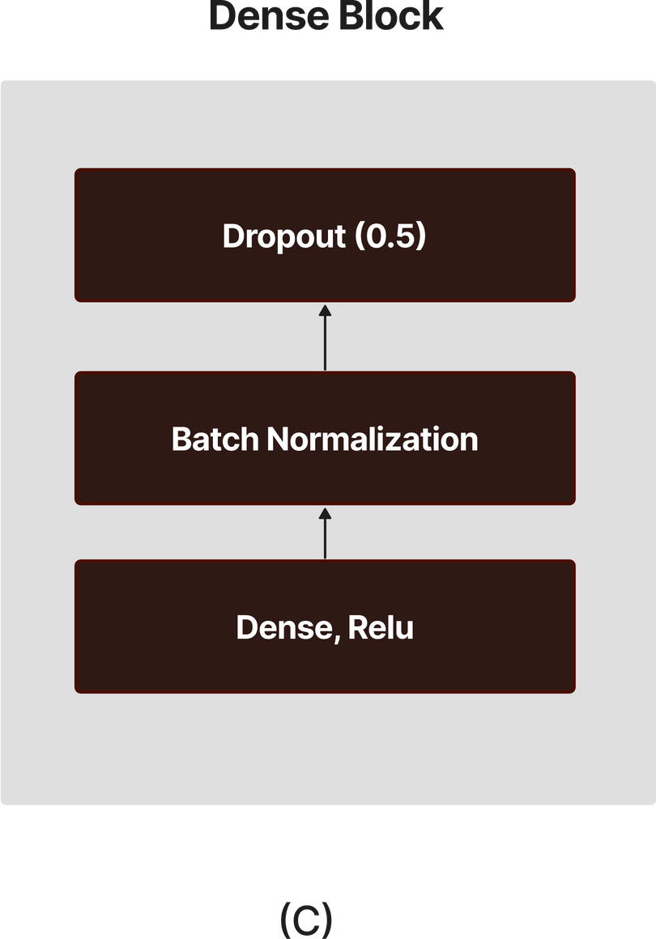
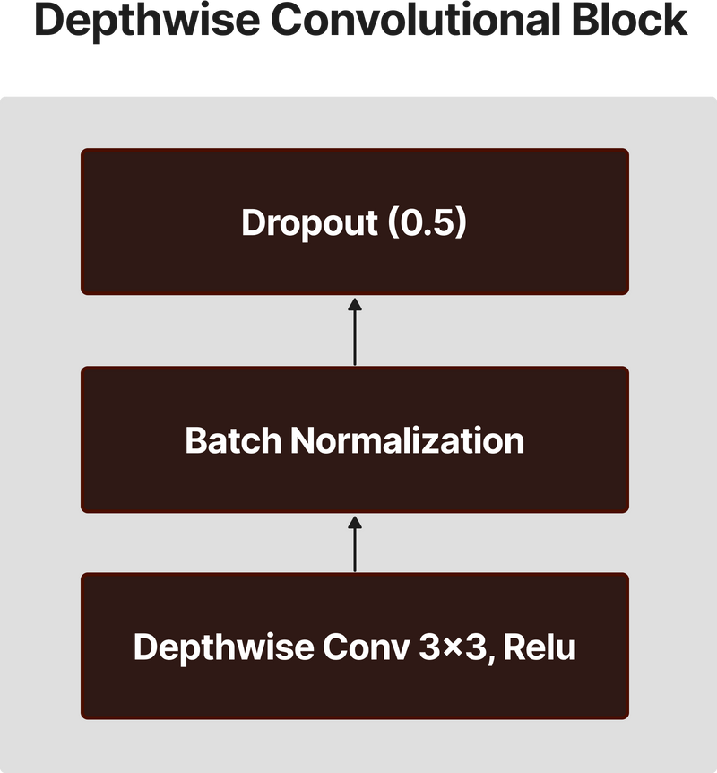
ARCHITECHTURE
MODEL 1

Slide 10
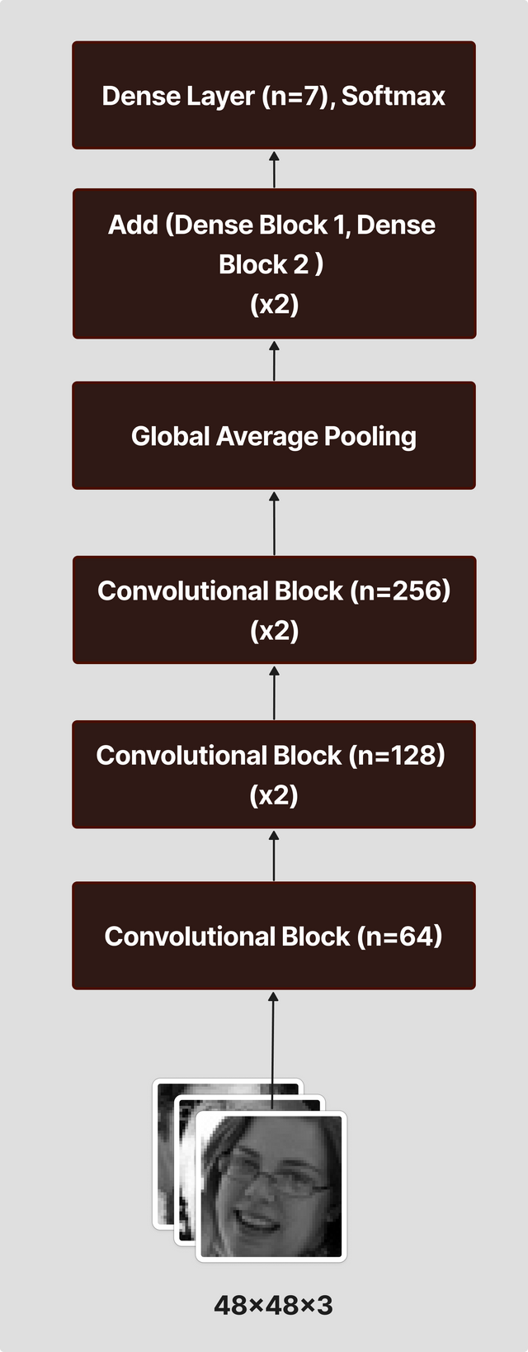
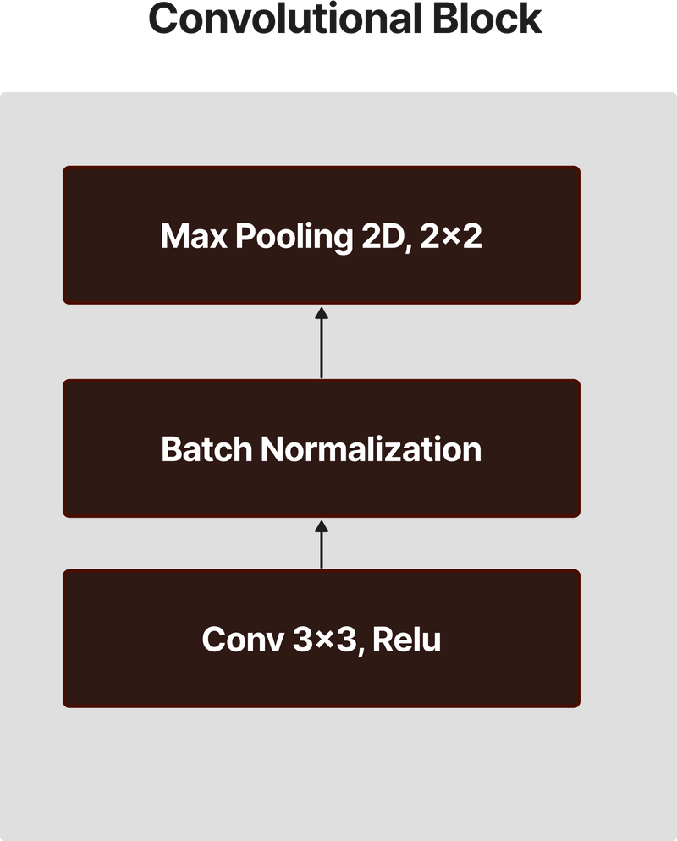
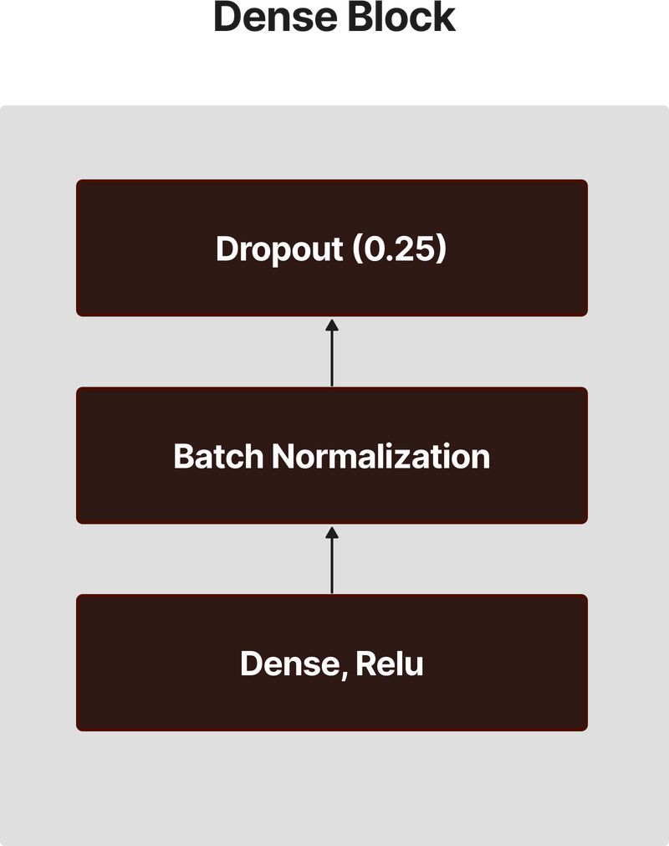
ARCHITECHTURE
MODEL 2

Slide 11
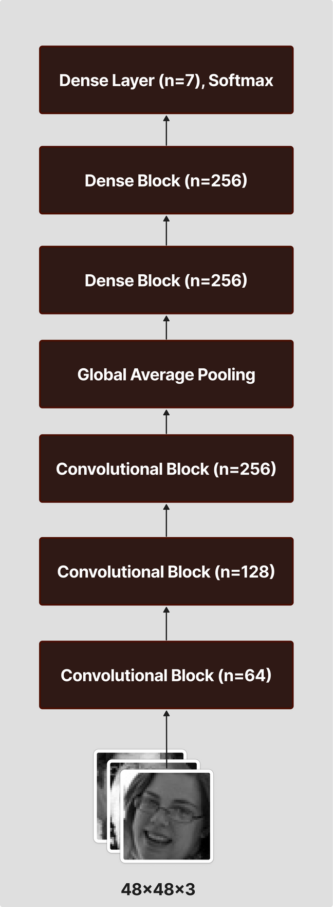
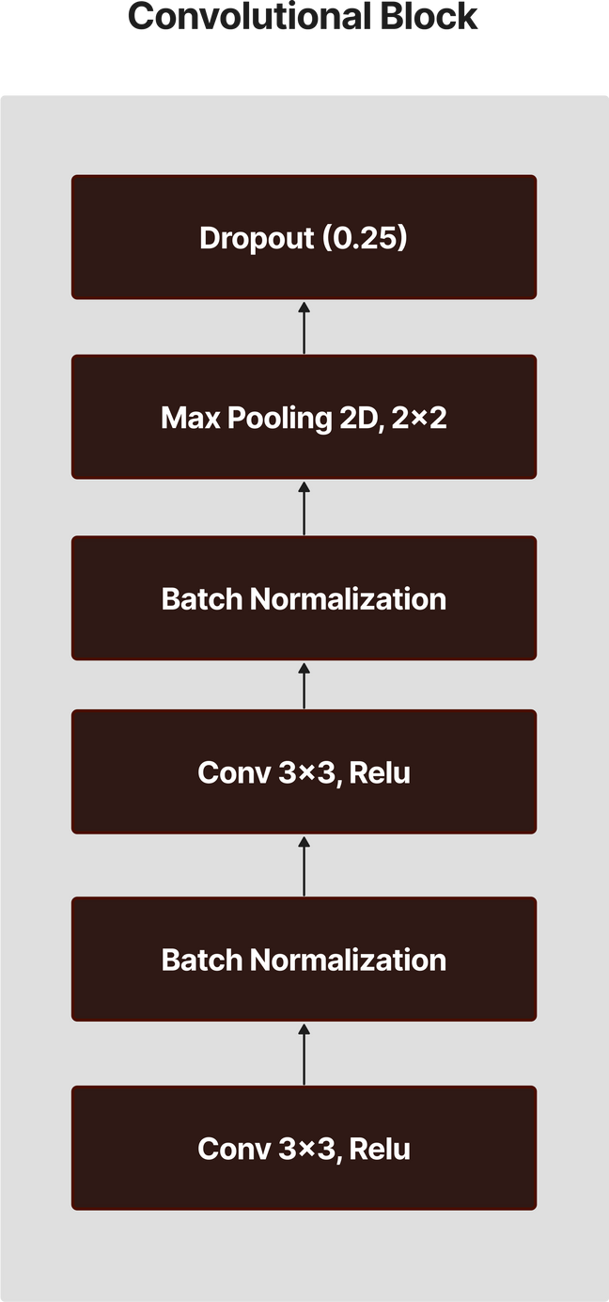
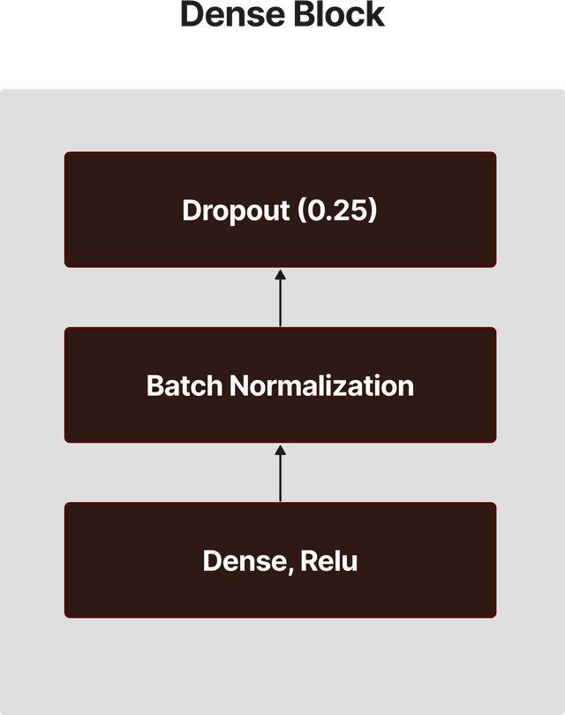
ARCHITECHTURE
MODEL 3

Slide 12

Training Methodologies
1
DATA AUGMENTATION - to improve detection,recognization of images
2
REDUCED LEARNING RATE - to get an optimal solution
3
50 EPOCHS USED - to reach to a saturated point

Slide 13
PERFORMANCE METRICS
Models | Accuracy | Precision | Recall | F1-Score
Model 1 | 67% | 68% | 67% | 67%
Model 2 | 69% | 69% | 69% | 68%
Model 3 | 68% | 69% | 68% | 69%
Combined Models | 69% | 70% | 69% | 69%

Slide 14
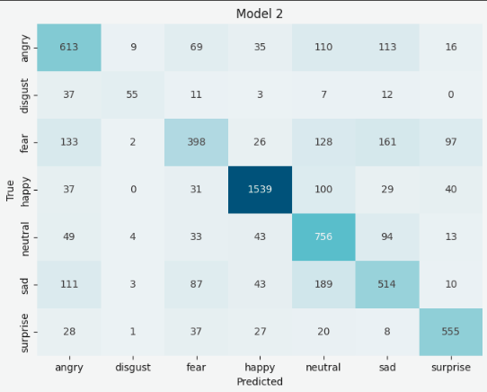
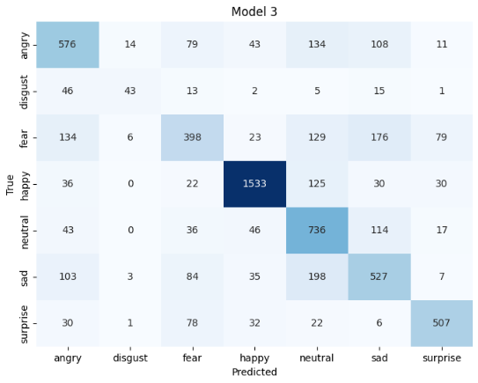
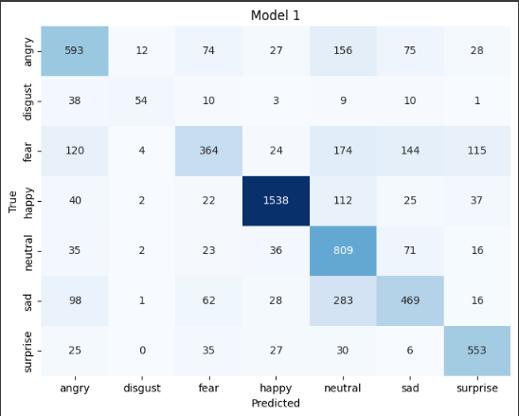
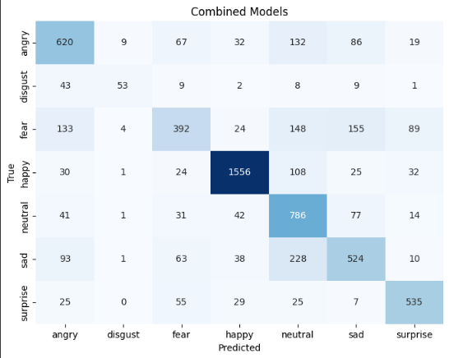
EVALUATION METRICS
ACCURACY OF EACH MODEL
MODEl 1
67%
MODEL 2
69%
MODEL 3
68%
COMBINED MODELS
69%

Slide 15













Tech Stack

Slide 16
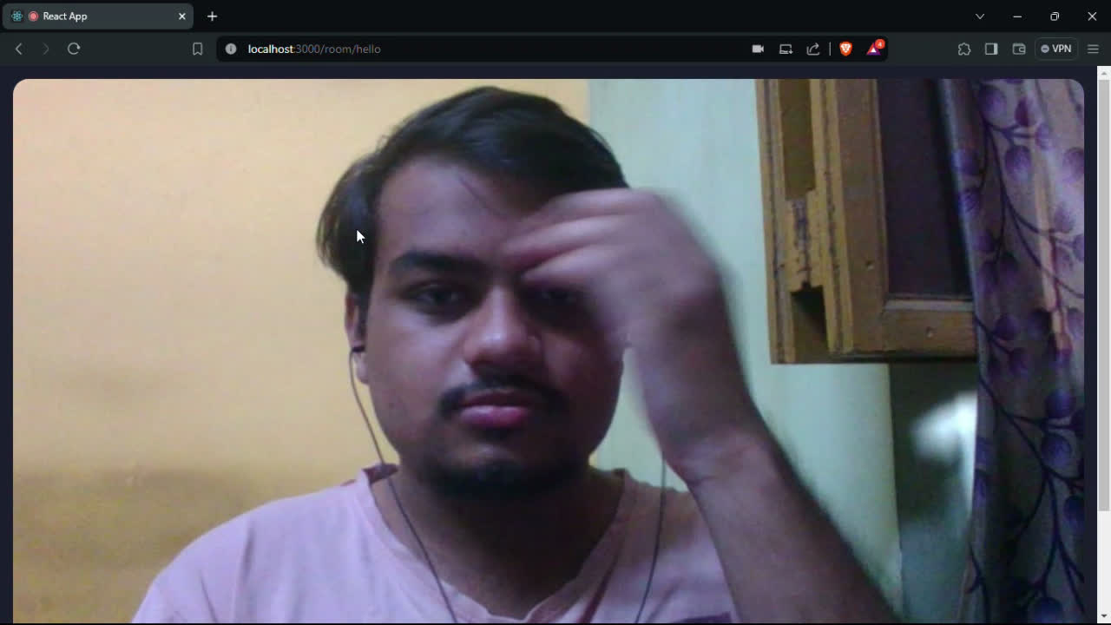

Slide 17
ADVANTAGES
Enhanced online meeting interaction
Application is suitable for low end devices
Majority voting of 3 combined
models

Slide 18
CHALLENGES FACED
Limited Data for some emotions - like “Disgust”
Lack of Computational Resources
Need to have strong/precise expressions/emotions

Slide 19


Conclusion
In this project we have covered the emotion recognition technology , it holds an immense potential. In this project an emotion of an individual is detected by capturing his/her face .
This can work on both static images as well as on live video. One big use of this project is done in online meeting platform. After detecting the emotion of an individual it suggests the overall meeting experience to the host .

Slide 20

images.app.goo.gl/JiyS6YQLGHeMd52N6
https://images.app.goo.gl/qkNnsAWhTiNFRFRR9
https://images.app.goo.gl/JiyS6YQLGHeMd52N6
https://jpgimages.app.goo.gl/JiyS6YQLlaODAed52N6
Resource Page
images.app.goo.gl/JiyS6YQLGHeMd52N6

